Slide 1

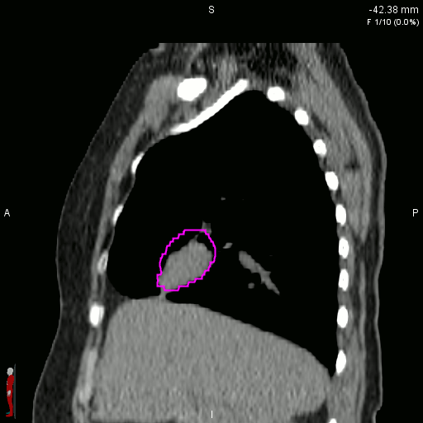
Motion management in Radiotherapy
Technical and Clinical perspective
Presented Platform : Global Alliance for Medical Physics Education and Research (GAMPER)
Dr Kanhu Charan Patro
MD,DNB(Radiation Oncology),MBA,FICRO,FAROI(USA),PDCR,CEPC
Clinical Director, HOD (Radiation Oncology)
ISRo- Institute of Stereotactic Radiation oncology
Mahatma Gandhi Cancer Hospital & Research Institute, Visakhapatnam
drkcpatro@gmail.com /M- +91-9160470564/ www.drkanhupatro.com

Slide 2
What is SBRT- THE TRIO?
Ultrahigh dose radiotherapy
Strict immobilization
Motion management

Slide 3
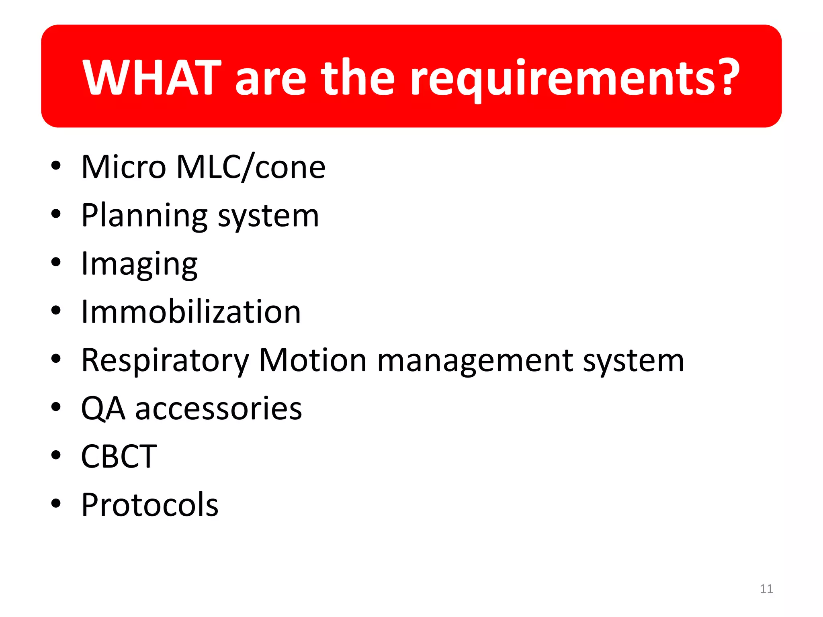

Slide 4
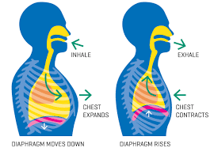

Slide 5
Organs effected by respiration
Lung
Mediastinum
Heart
Breast
Pancreas
Liver
Kidney
Biliary

Slide 6
Is lung moves?
Yes
As you go from apex to Lower movement increases
As you go from medial to lateral movement increases

Slide 7
Motion direction
Superior inferior
Mediolateral
Anteroposterior

Slide 8

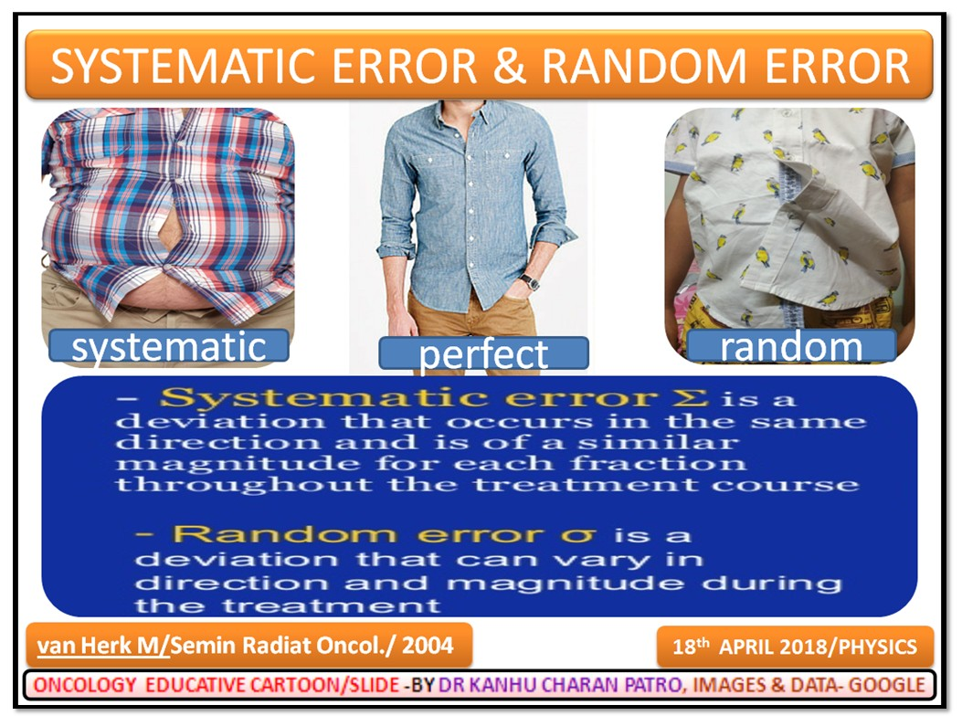
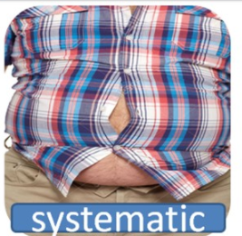
Errors

Slide 9
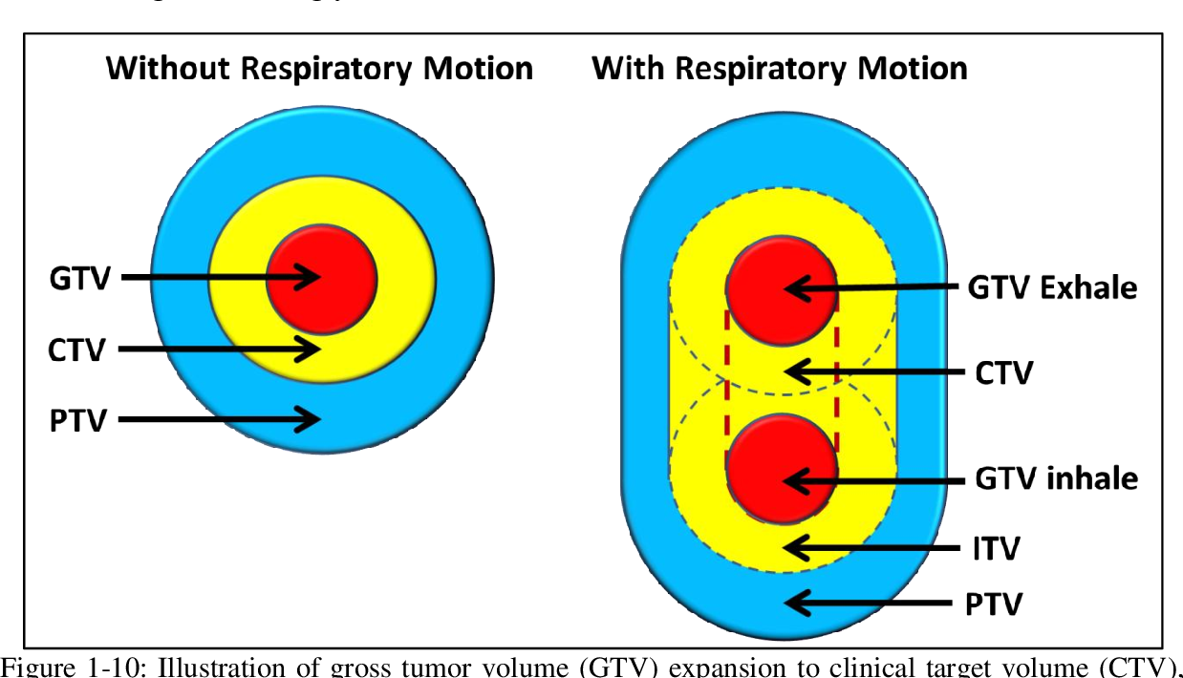
MOVEMENT OF TARGET

Slide 10
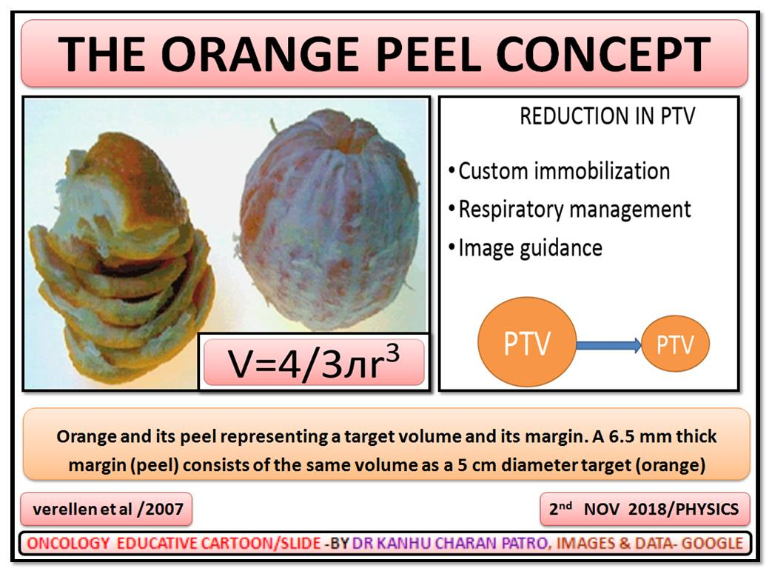

Slide 11
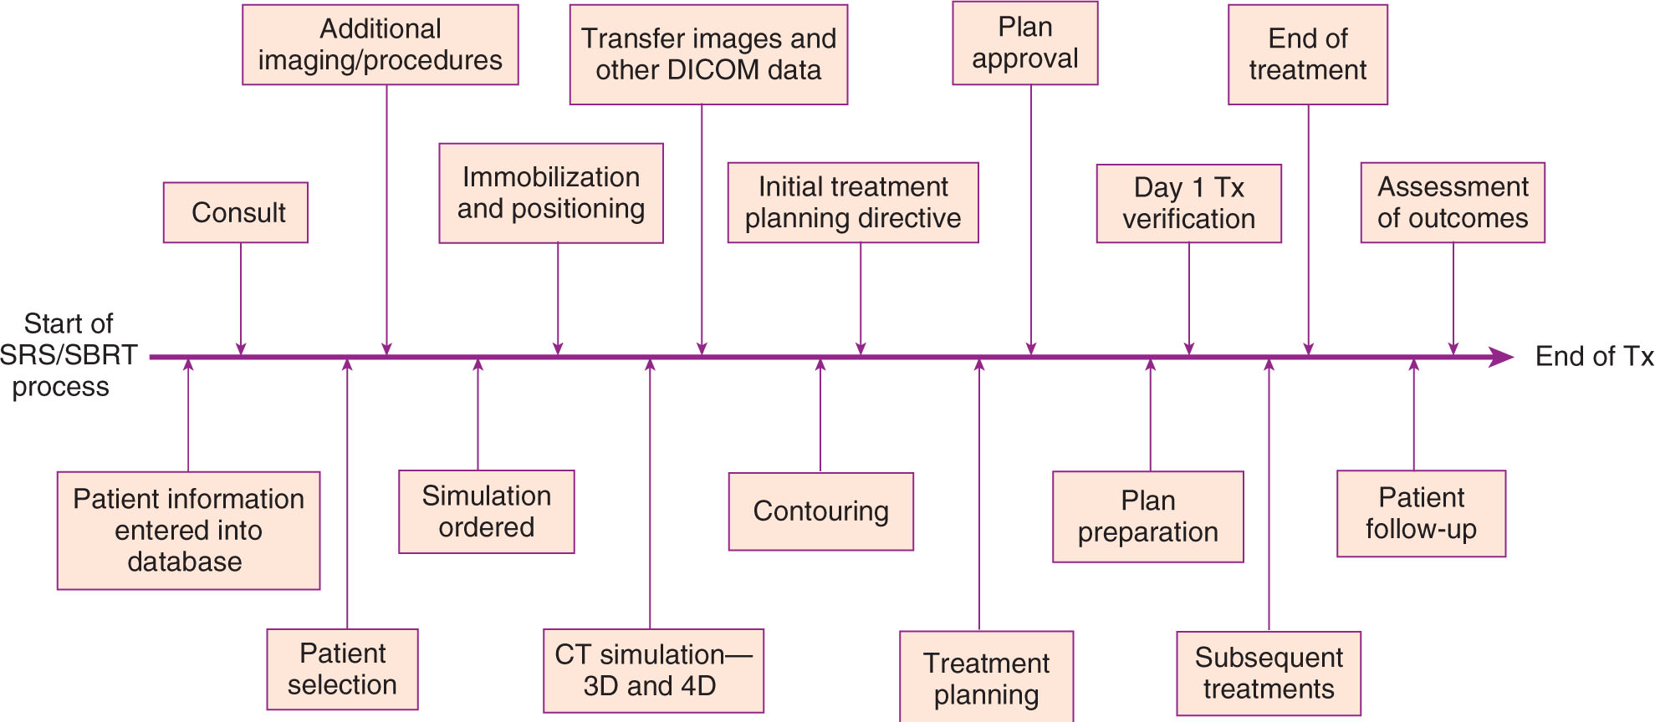
SBRT STEPS
MOTION MX

Slide 12
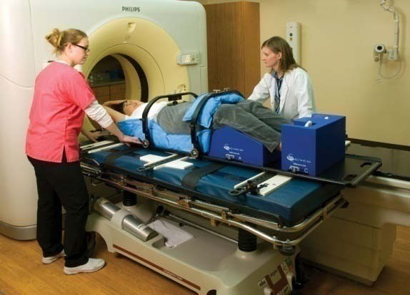
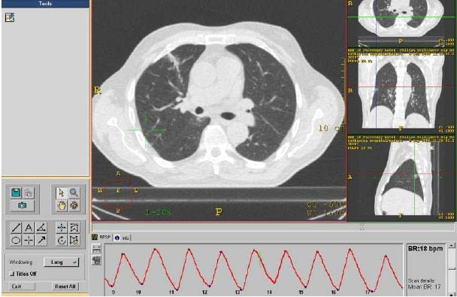
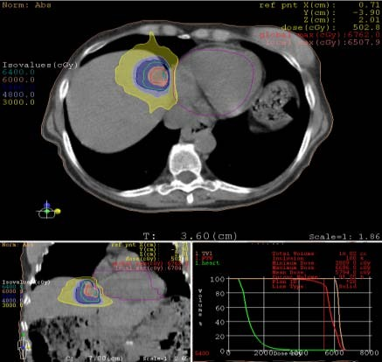
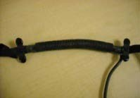




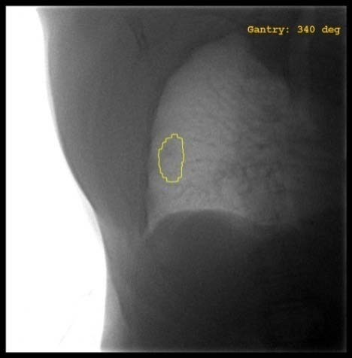
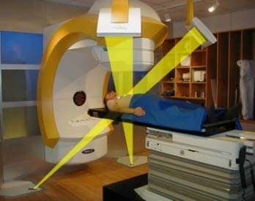
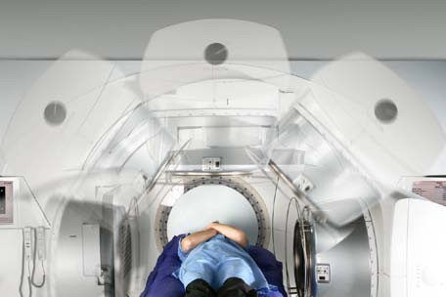

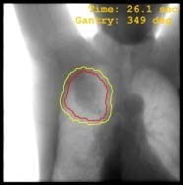
SBRT WORKFLOW
Simulation
Motion Management
Planning
TX
Delivery
Delivery
Motion Verification Localization

Slide 13
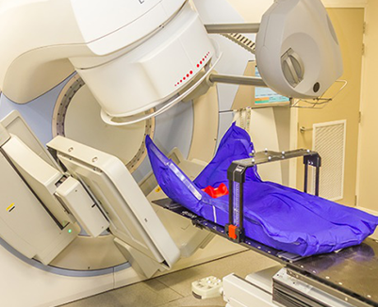
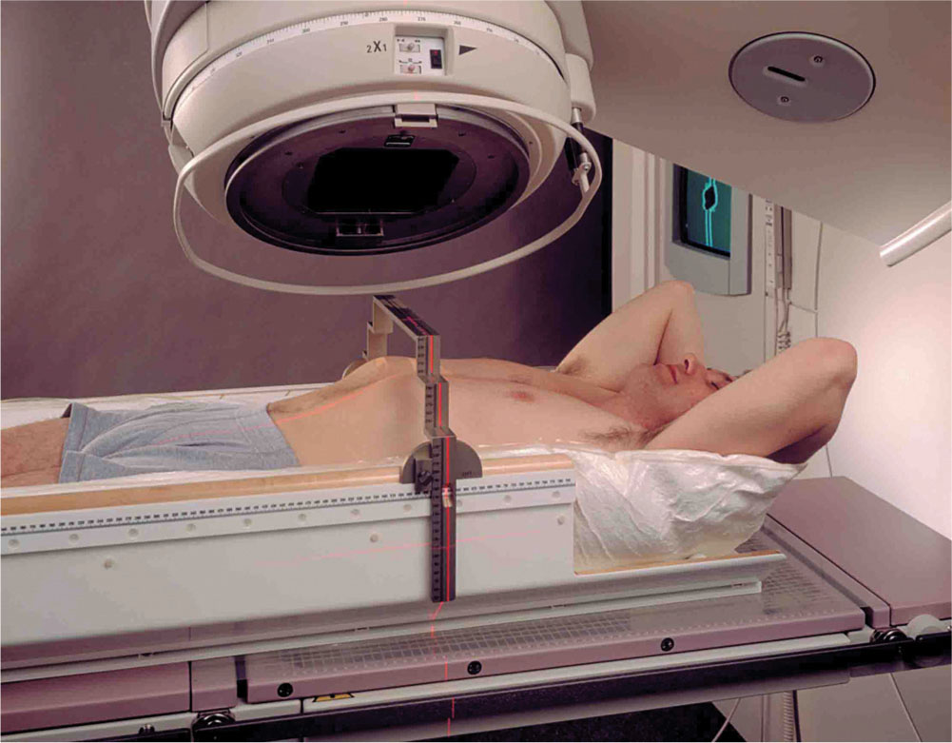
SBRT – Immobilization

Slide 14
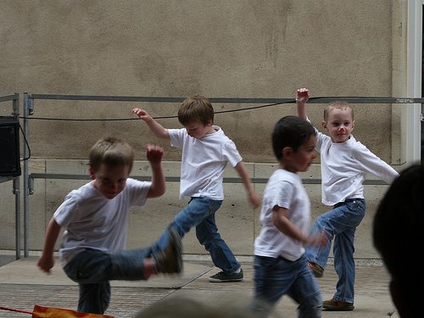
ORGANS DO NOT FOLLOW STATUE GAME

Slide 15
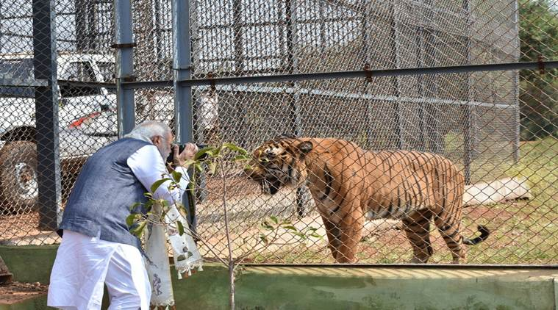
Everybody is a king when everything is inside the ring [PTV]

Slide 16
Motion Management

Slide 17
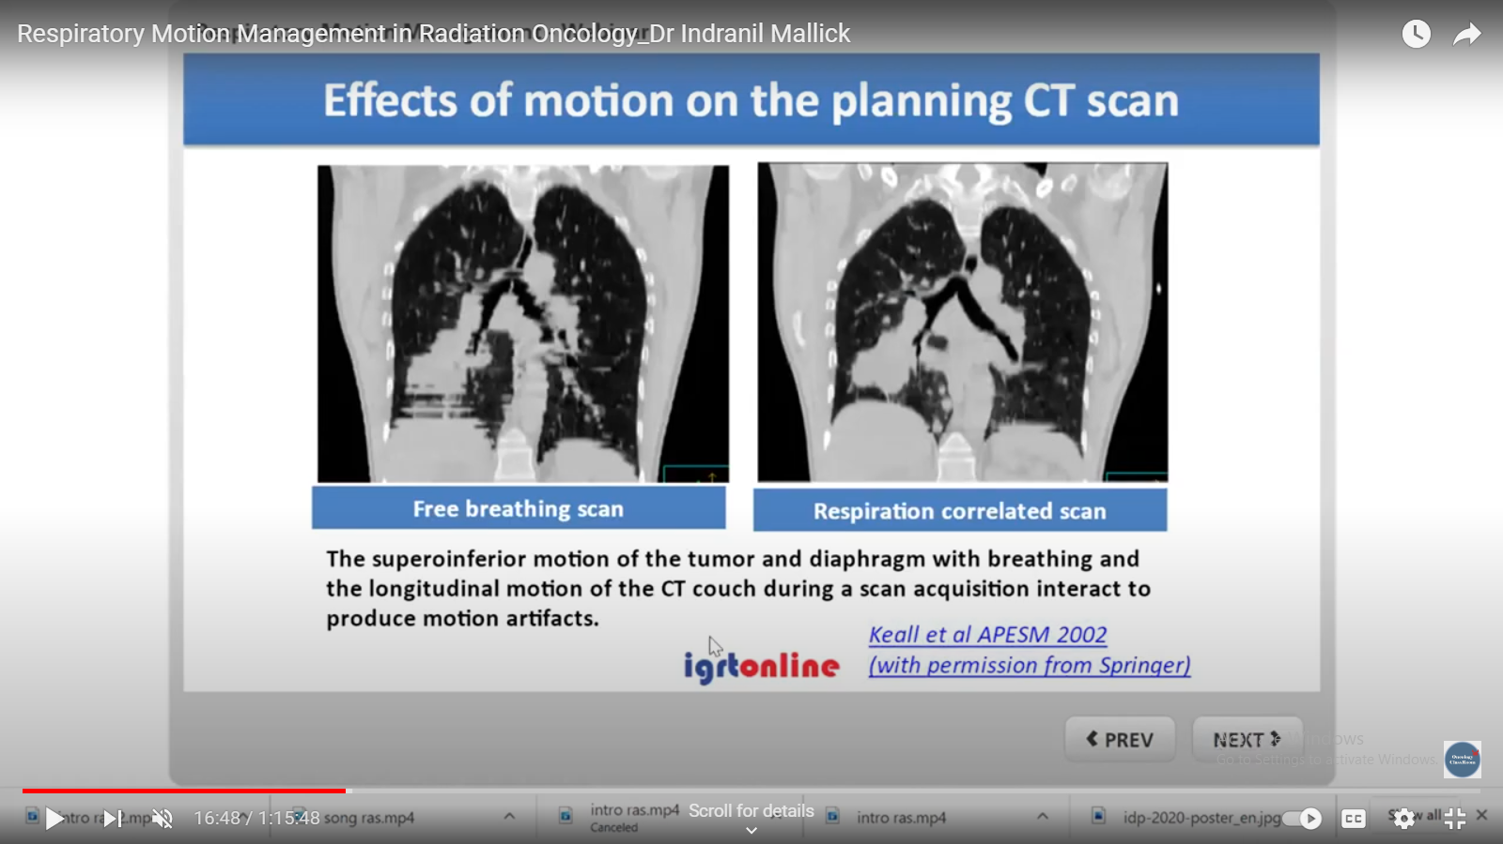
Free breathing VS Motion managed

Slide 18
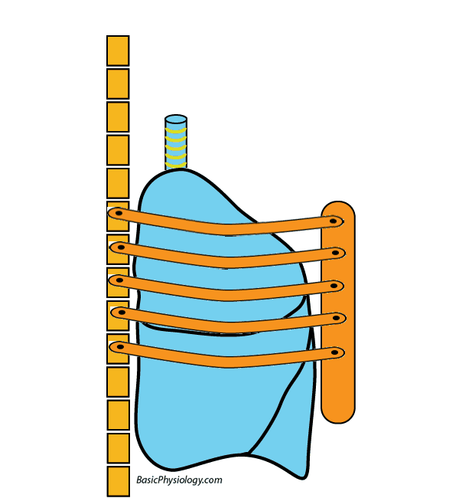
Is motion being straight forward?
No
Hysterical motion

Slide 19
GROSSLY
ITV generation
Abdominal compression
Breath holding
Gating
Tracking

Slide 20
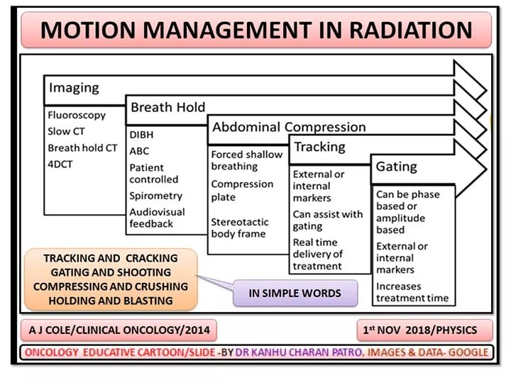

Slide 21
What are the available menu?
ELEKTA – ABC - BREATHHOLD
VARIAN - RPM
CYBERKNIFE – SYNCHRONY
CYBERKNIFE- FUDICAIL
OTHER
  COMPRESSION- ABDOMINAL COMPRESSION
  ITV GENERATION
  VOLUNTARY BREATH HOLD

Slide 22
ITV GENERATION

Slide 23
ITV GENERATION
Fluoroscopy mode
4D CT
SLOW CT
MULTIPHASE CT

Slide 24
4D CT
4D CT uses a new technology that captures the location and movement of your tumor and the movement of your body's organs over time.
This is valuable for accurately treating tumors located on or near organs that move, such as those in the chest and abdomen.
4D CT describes various techniques for obtaining CT data correlated with patient respiratory phase information so that the changes associated with respiration (or other motion) are displayed.
Phasing the respiratory cycle

Slide 25
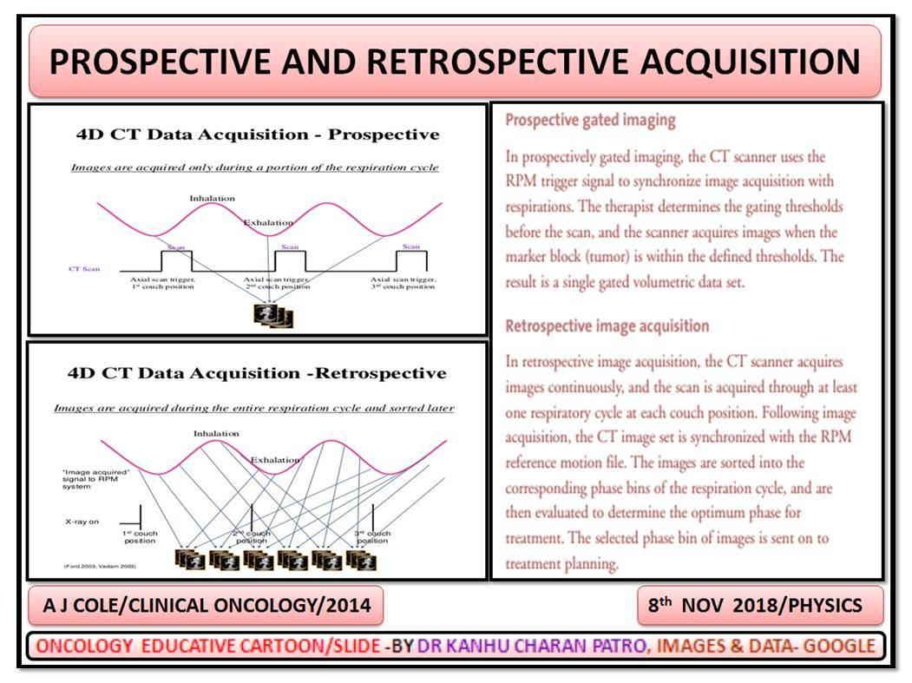

Slide 26
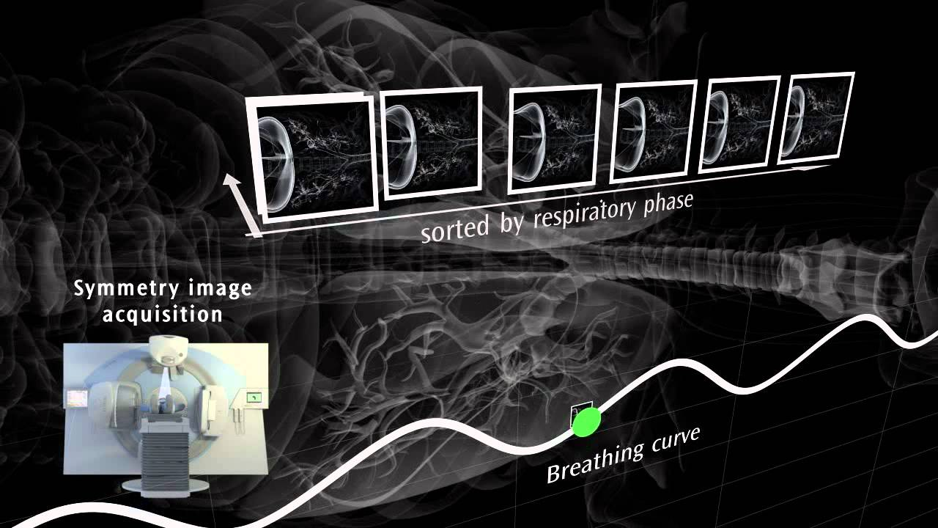
Elekta symmetry Rspiratory phase acquisition

Slide 27
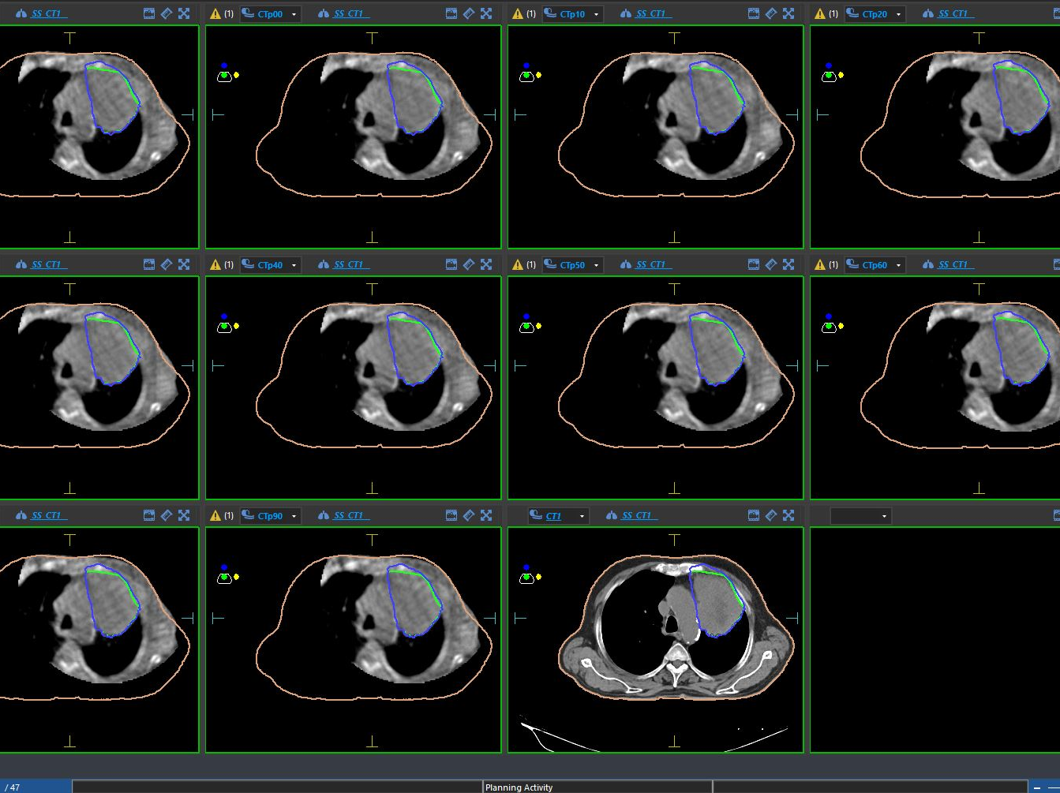

Slide 28
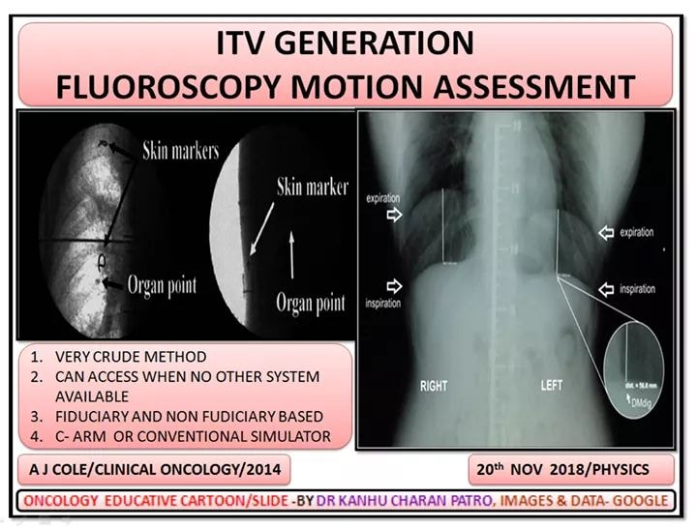

Slide 29
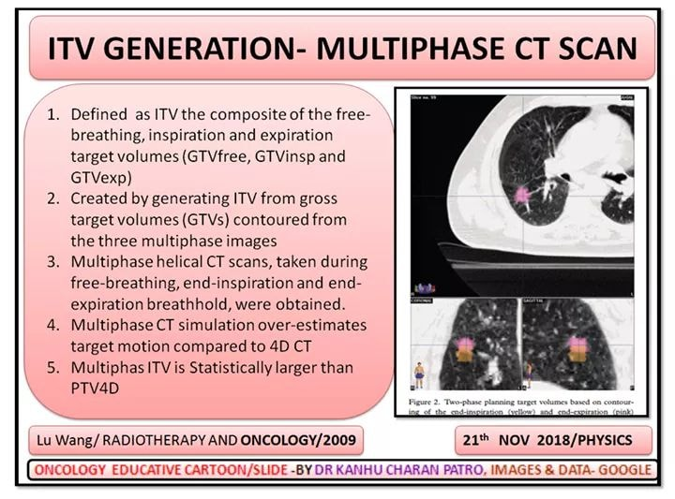

Slide 30
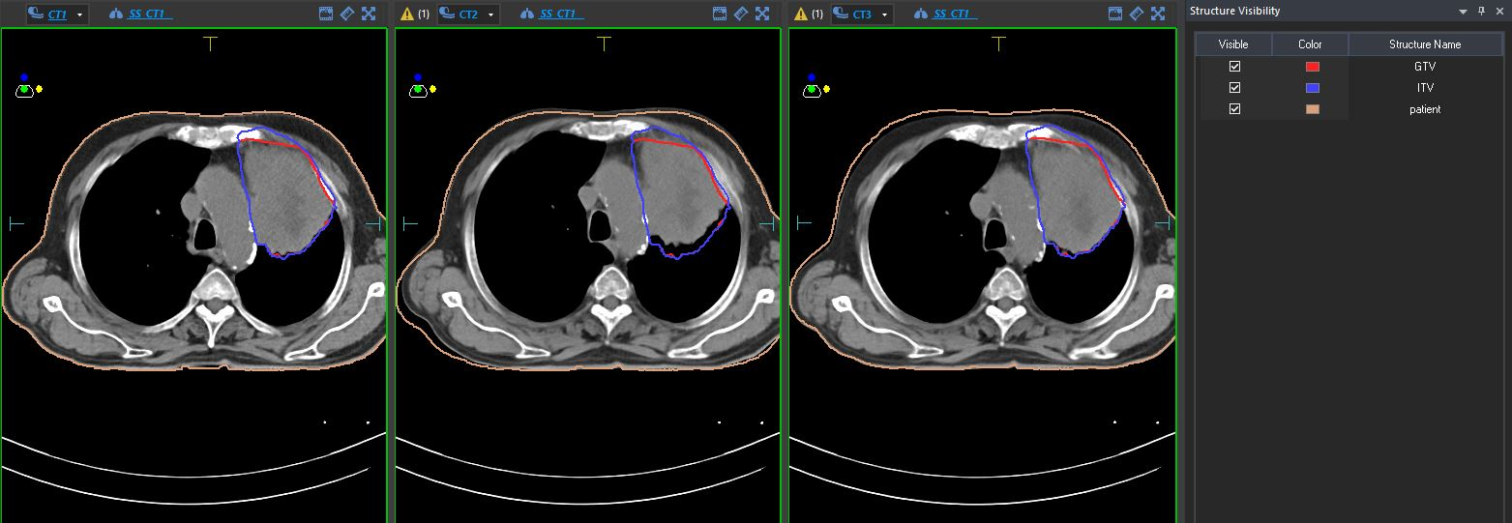
MULTI PHASE SCAN
INSPIRATION
EXPIRATION
FREE BREATH

Slide 31
Artefact in motion mx
Slice thickness
Pitch
Phase of respiration

Slide 32
SLOW CT
Computed tomography scan operated slowly and/or multiple slices taken are averaged, i.e. multiple phases of respiration are recorded by slice
Generally available on most computed tomography scanners.
Loss of resolution, which may lead to tumor blurring and subsequent increase in observer error in tumor and OAR delineation

Slide 33
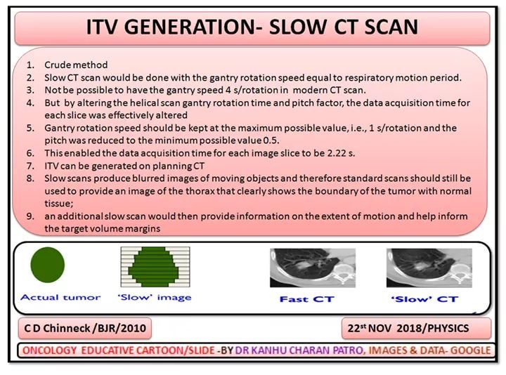

Slide 34
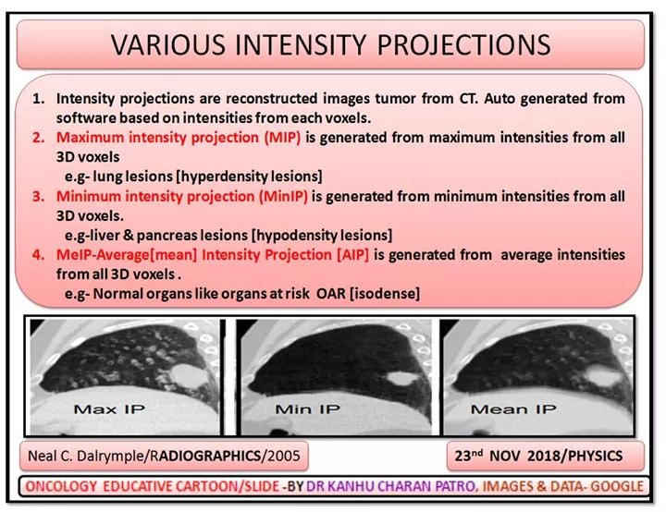

Slide 35
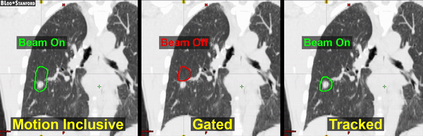

Slide 36
Abdominal compression

Slide 37
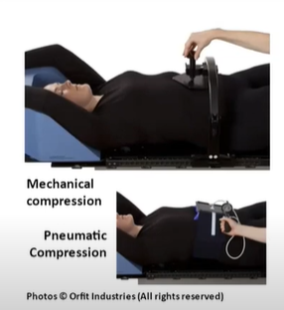
Abdominal compression

Slide 38
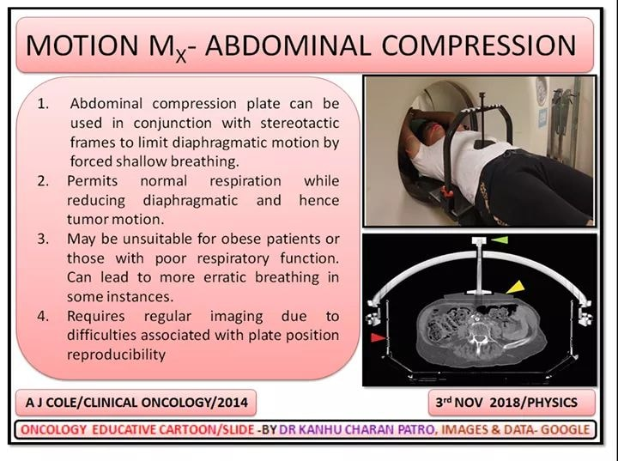

Slide 39
Breath holding

Slide 40
HOLDING
Assists breath-hold by use of a valved spirometer. Often at moderate or deep breath-hold.
Can reduce motion artefacts. Improvements in dose to organs at risk.
Potential for dose escalation compared
with free-breathing technique
Patient selection important; non-compliance of patients with poor respiratory function.
Increase in quality assurance procedures

Slide 41
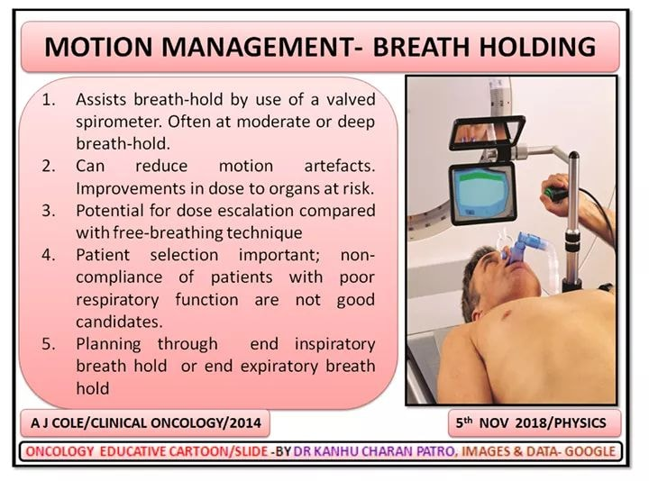

Slide 42
ELEKTA ABC
Active breath coordinator
Based on breath hold
During breath hold treatment
Works like spirometry
Needs good lung function

Slide 43
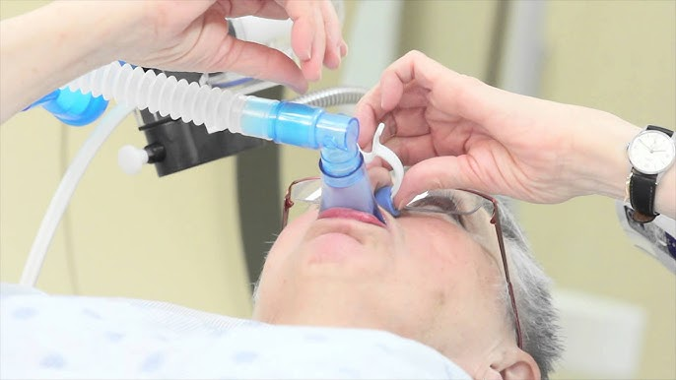
Nose and mouth piece

Slide 44
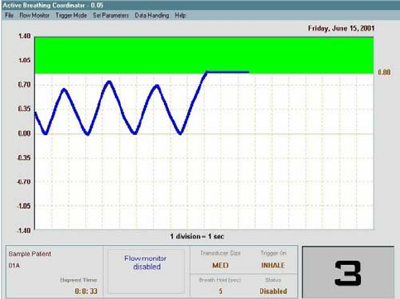
Green is the beam on

Slide 45
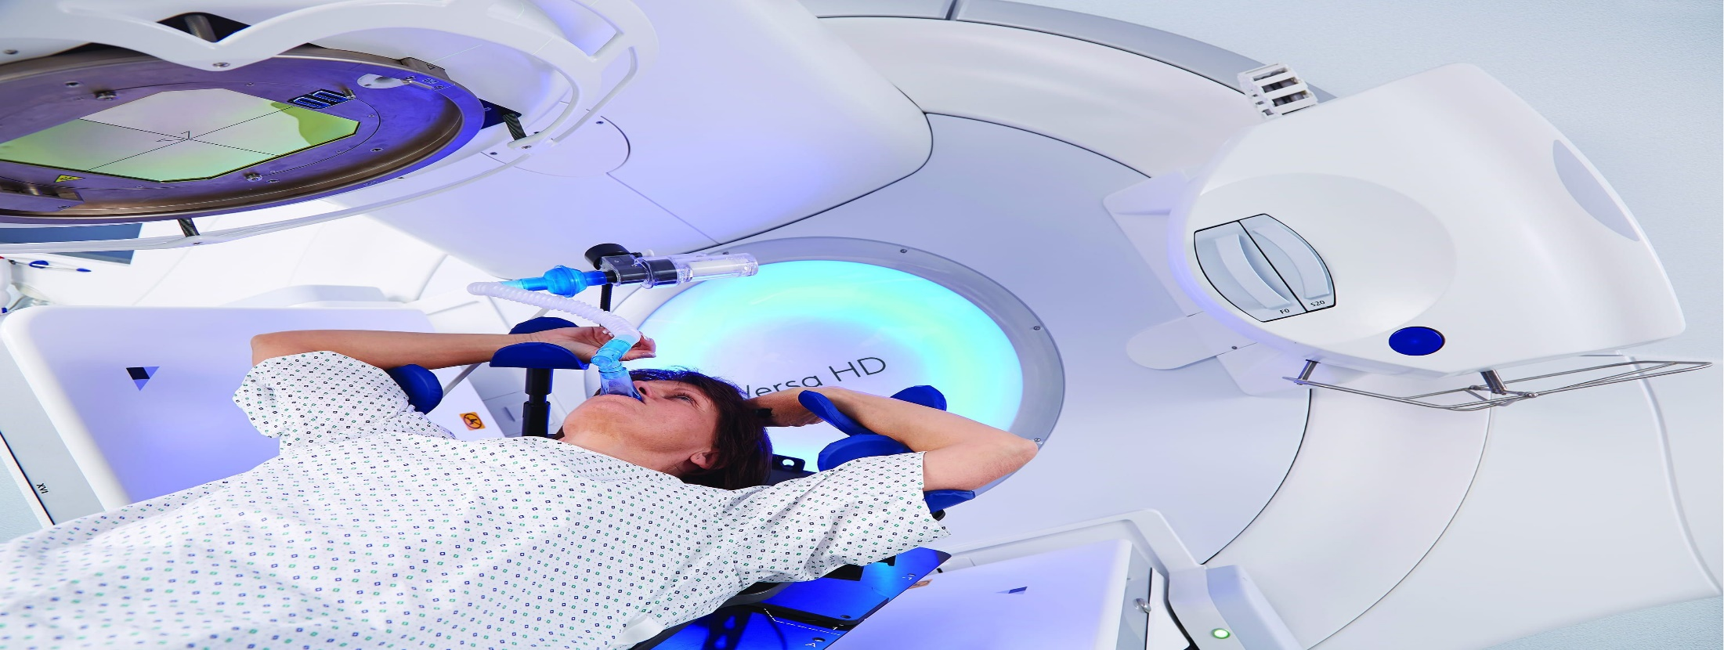
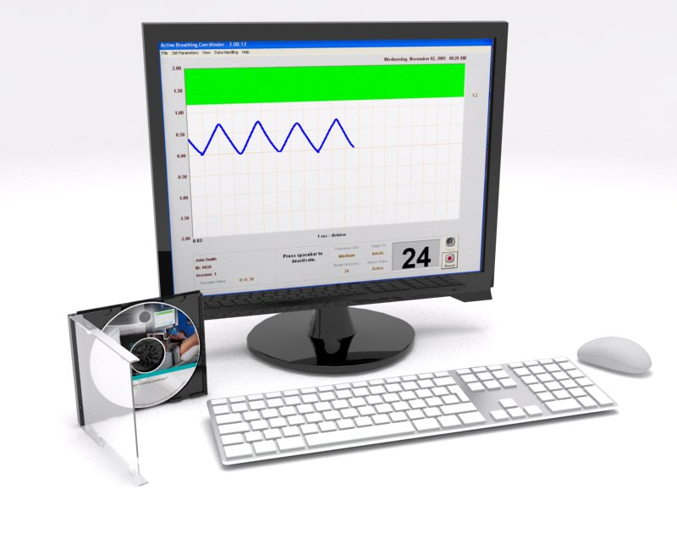
Elekta ABC

Slide 46

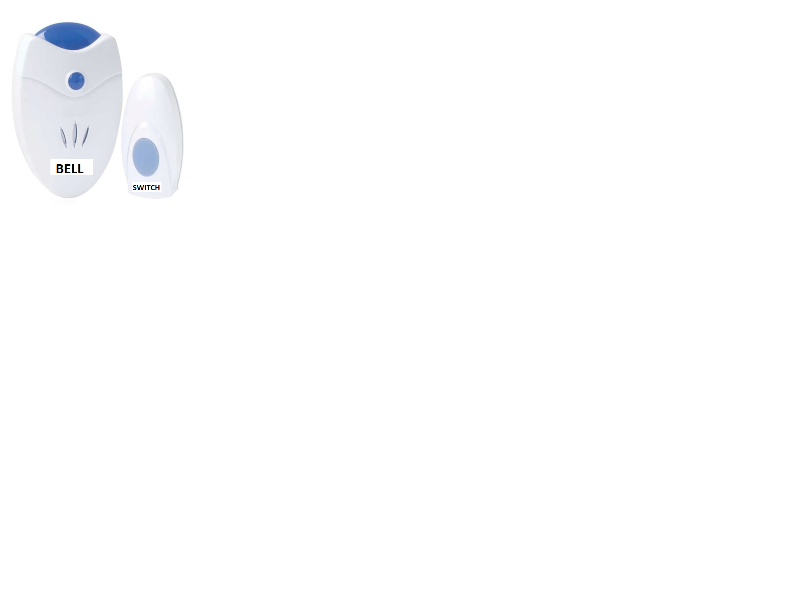
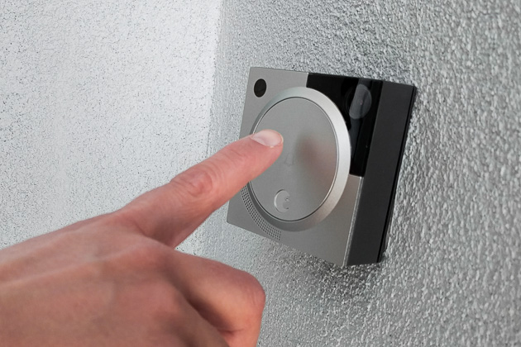
VOLUNTARY BREATH HOLD USING WIRELESS DOOR BELL

Slide 47
GATING

Slide 48
MIDDLE- BEAM GATING

Slide 49
ITV
Particular phase

Slide 50
GATING
Delivery of radiation within a specified part of the patient’s breathing cycle termed ‘the gate’.
Phase or amplitude based.
Uses external respiration signal e.g. infrared, spirometry, thermistors or internal fiducials. internal fiducials.
Imaging and treatment synchronised with patient’s breathing cycle

Slide 51
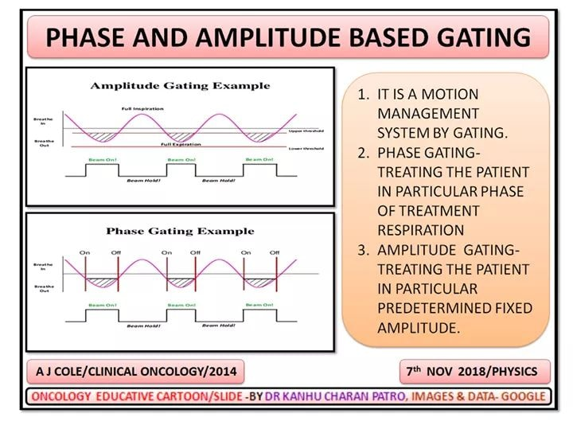

Slide 52
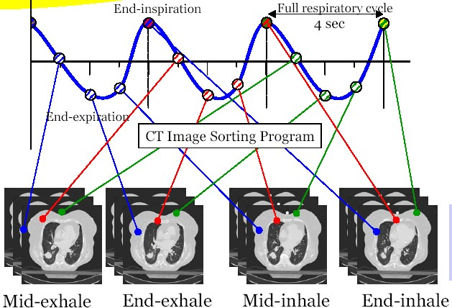
PHASE BASED TREATMENT-
CHOOSING PART OF DUTY CYCLE

Slide 53
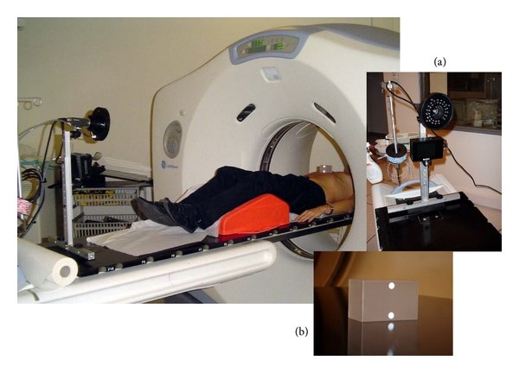
Varian RPM gating synchronization

Slide 54
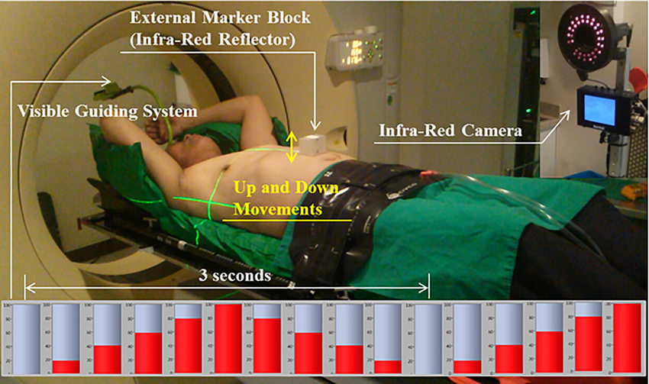

Slide 55
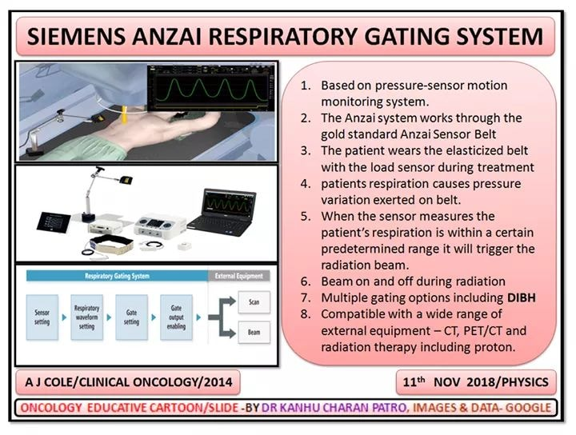
PRESSURE SENSOR GATING

Slide 56
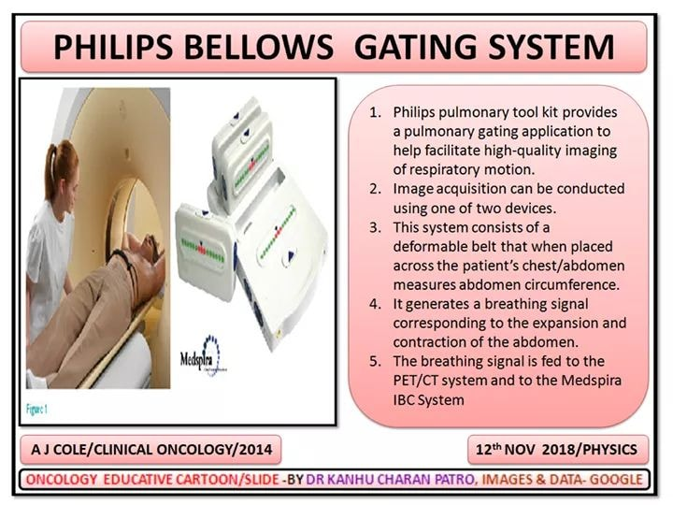

Slide 57
Camera based gating

Slide 58
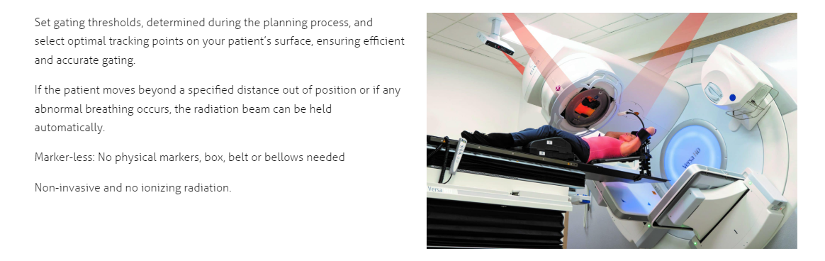
Vision RT- SGRT - GATE RT

Slide 59
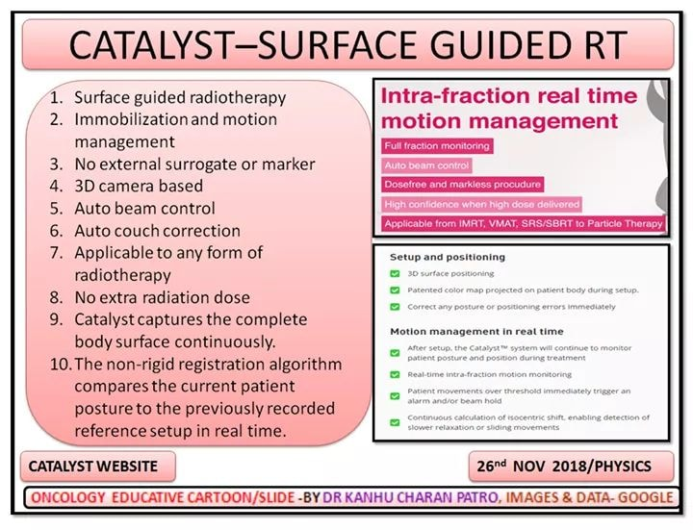

Slide 60
Tracking

Slide 61
Last one – tracking the tumor

Slide 62
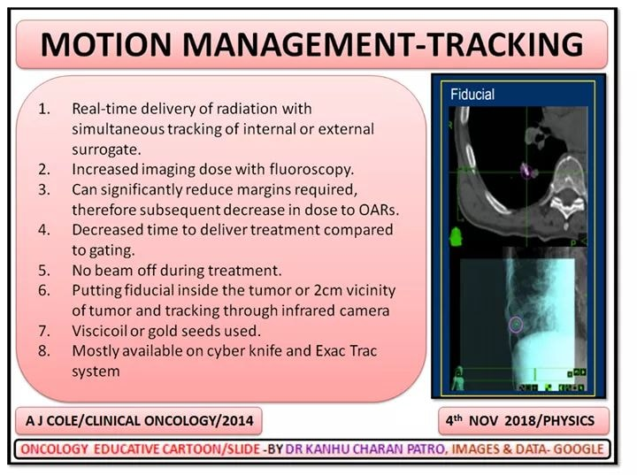

Slide 63


Slide 64


Slide 65


Slide 66


Slide 67


Slide 68



Slide 69

Synchrony

Slide 70

Synchrony

Slide 71


Slide 72
IN SUMMARY

Slide 73
External signal – Gating
  Amplitude based
  Phase based
Internal signal - Tracking
Breath hold is also a type of amplitude based gating

Slide 74

Various Motion management systems

Slide 75


Slide 76


Slide 77


Slide 78

MOTION MANGEMENT VIDEO

Slide 79
WHICH MOTION MANAGEMENT SYSTEM IS BETTER?

Slide 80

ANSWER- WHAT MANAGEMENT ACQUIRES

Slide 81

Managing the Management

Slide 82

Stereotaxy class

Slide 83

Target delineation class

Slide 84

Radiology class

Slide 85

Neurooncology Class

Slide 86










SRS/SBRT

Slide 87

Kanhu
drkcpatro@gmail.com
M→+91 9160470564

Slide 88



GET THE PRESENTATION HERE
ONCOEDUCATION APP
DOWNLOAD ONCOEDUCATION APP
Indian students sign up with mobile
International students sign up with e mail
APPLE/IOS CODE- LRIWPA( My Institute)
drkcpatro@gmail.com
M- +91-9160470564 www.drkanhupatro.com

